Slide 2
ABOUT US
Transformation Apex provides advisory, consulting and delivery of digital transformation solutions dedicated to driving innovative change and sustainable growth for businesses with a vision of helping organizations navigate the complexities of the modern business landscape.
We leverage the latest technologies and industry best practices, enabling our clients to achieve their strategic goals, enhance customer experiences and gain a competitive edge.
At Transformation Apex, we believe in the power of transformation to unlock potential and create lasting value, with a mission to empower businesses to innovate, adapt, and thrive in an ever-evolving business landscape.
1

Slide 3
SERVICES
PORTFOLIO
ANALYTICS
ENTERPRISE
RESOURCE
PLANNING
CUSTOMER
EXPERIENCE &
CRM
DATA
MANAGEMENT
BUSINESS
PROCESS
MANAGEMENT
DIGITAL
INNOVATION
2

Slide 4
Data Management
Data Warehouse
Data Lakehouse
Data Strategy
Data Orchestration
Data Pipeline Management
Data Privacy and Security
2

Slide 5
Business Process
Management
Finance Transformation
Workflow Transformation
Governance Risk & Compliance Automation
Expense Management
Custom Workflow Digitalization
2
3

Slide 6
Technology Innovation
Artificial Intelligence
Machine Learning
Generative AI
AI product development
Internet of Things
AI in Banking
AI in Supply Chain
AI in Retail/Customer Experience
4

Slide 7
Enterprise Resource
Planning
SAP
S/4 HANA – Customization, Optimization, Integration
SAP Analytics
Business Process Optimizations & Automation
SLA Support
Oracle ERP Cloud
Microsoft Dynamics 365
Odoo
5

Slide 8
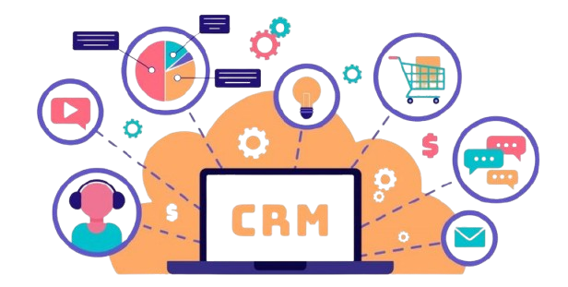
Customer Experience
& CRM
Sales Management
Integrated Marketing
Customer Support & Success
Chatbots
WhatsApp Integration
6

Slide 9
Analytics
Technology Agnostic Enterprise Analytics Strategy
Finance Analytics
Human Resource Analytics
Supply Chain Analytics
Operations Analytics
7

Slide 10
Partners & Associates
IBM
Creatio
PurpleCube
D4Transform
Transformation Enablers
LinkedThings
ANQA
DataBorn
Dost AI
8

Slide 11
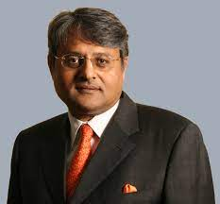
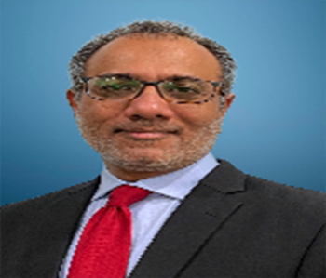
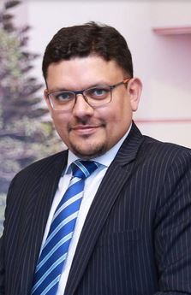
Leadership
 | Sohail Wajahat Siddiqui – Sitara I Imtiaz
 | Executive Vice Chairman - THK Group Former Federal Minister - Petroleum & Natural Resources, Chairman - Pakistan State Oil MD & CEO - Siemens West Asia & Pakistan
 | Hasnain Gangjee
 | Partner Technology Consulting - THK Group Managing Director & CEO – Transformation Apex
 | Shomail Naqvi
 | Group Managing Director - THK Group
9

Slide 12
Finance Transformation
10

Slide 13
Workforce Transformation
11

Slide 14
GRC Automation
12

Slide 15
Expense Management
13

Slide 16
Artificial Intelligence
14

